Slide 1
Diamond Price Prediction
By Jawahar Aravind G

Slide 2
Agenda
Problem Statement
Project flow
Data Collection
PreProcessing
DataFrame1
Outliers
Dataframe2
Feature Selection
DataFrame3
Demerits
Conculsion

Slide 3
Problem Statement
The dataset is based on the information of the diamond price prediction given in the model.
The objective is to develop a machine learning model capable of predicting customer satisfaction in the diamond purchasing process.
Developing a machine learning model for accurate price of diamond using shape data and clarity co-ordinates.

Slide 4
Flow of Project
Data Collection
Data Preprocessing
Data Frame 1
Outliers
Data Frame 2
Feature Selection
Data Frame 3

Slide 5
Data Collection
In Dataset there are 50000rows and 10 columns.
It has 8 columns consist of numerical values and 2 are categorical.

Slide 6
PREPROCESSING
Missing Value Treatment
Data Type Conversion
Duplicate Checking

Slide 7
DATA FRAME 1
 | ModelName | R-Square | Adj-R2 | MSE
0 | Linear | 0.910672 | 0.910651 | 762017.816762
1 | Lasso | 0.910658 | 0.910638 | 758132.923553
2 | Ridge | 0.910671 | 0.910651 | 761951.829739
3 | XGB | 0.992864 | 0.992863 | 102580.905038
4 | Random_Forest | 0.998380 | 0.998379 | 105604.387728

Slide 8
Conclusion For Data Frame 1
For this model Random Forest is best fitted model it having (99.89%) R-Square and (0.99) Adj-R2 score and ( MSE is (105605) )

Slide 9
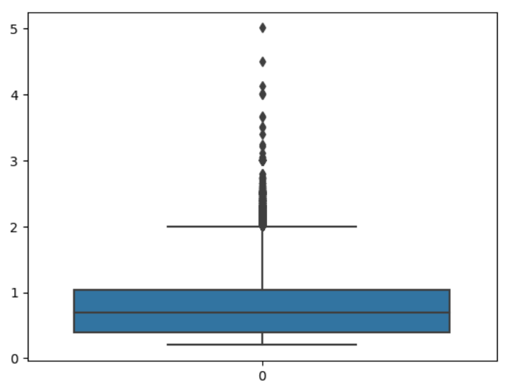
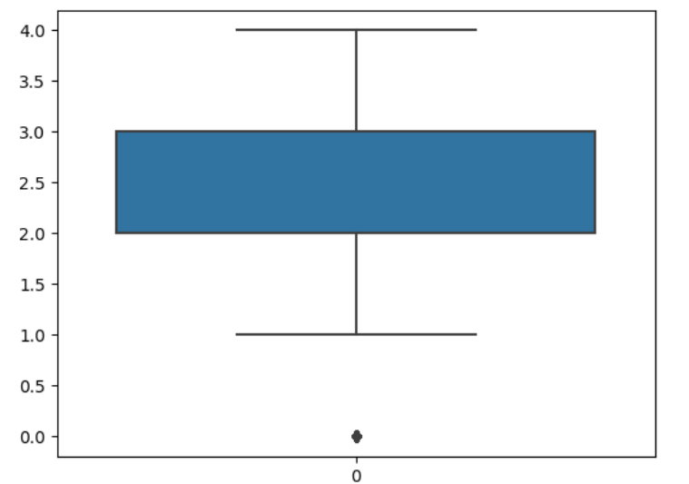
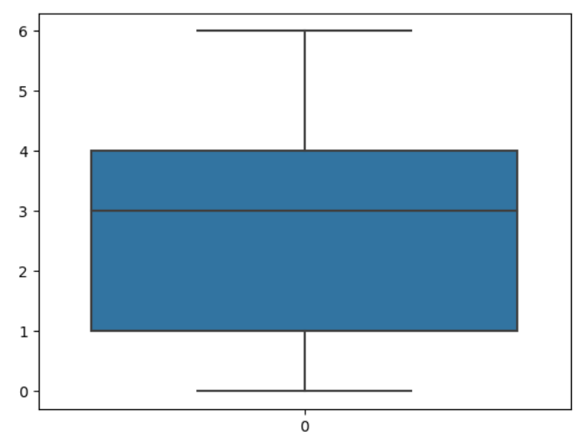
Outliers
Box Plot for Outlier in the Data
Cut
Colour
Carat

Slide 10
DATA FRAME 2
 | Modelname | R-square | Adj-R2 | MSE
0 | Linear | 0.887247 | 0.910651 | 862070.108530
1 | Lasso | 0.887199 | 0.887174 | 867780.908734
2 | Ridge | 0.887246 | 0.887221 | 862508.188791
3 | XGB | 0.992785 | 0.992783 | 101790.942205
4 | Random Forest | 0.998354 | 0.998354 | 107050.167189

Slide 11
Conclusion For Data Frame 2
For this model Random Forest is best fitted model it having (99.83%) R-Square and (0.99) Adj-R2 and ( MSE is (10705) )

Slide 12
Feature Selection
Dataset having 10 column in that only 7 column selected as a importance feature which are significant.

Slide 13
DataFrame 3
 | Modelname | R-square | Adj-R2 | MSE
0 | Linear | 0.887247 | 0.910651 | 862070.108530
1 | Lasso | 0.887199 | 0.887174 | 867780.908734
2 | Ridge | 0.887246 | 0.887221 | 862508.188791
3 | XGB | 0.992785 | 0.992783 | 101790.942205
4 | Random Forest | 0.998354 | 0.998354 | 107050.167189

Slide 14
Conclusion For Data Frame 3
For this model Random Forest is best fitted model it having (99.85%) R-Square and (0.99) Adj- R2 and ( MSE is (108638)) .

Slide 15
Demerits
Limited and Biased Data Availability
Complexity of Diamond Market Dynamics
Subjectivity in Diamond Evaluation
Overfitting and Generalization
Interpretability and Trust

Slide 16
Thank You

